Slide 1
Network Quantization
2018年7月
Notes:
此页可以删除

Slide 2
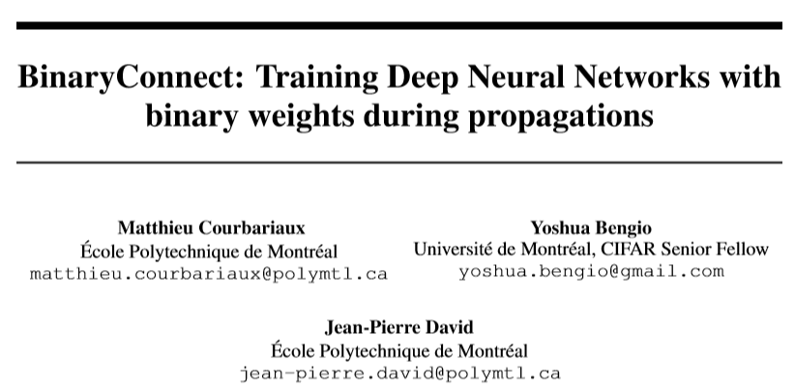
BC-Nips 2015

Slide 3
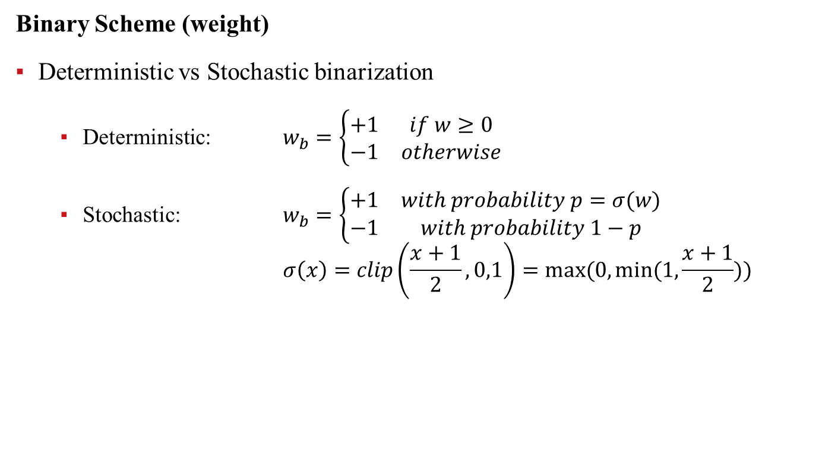
BC-Nips 2015
Binary Scheme (weight)
Deterministic vs Stochastic binarization
Deterministic: $w_{b}=\left\{\begin{matrix}+1 & if w≥0 \\ −1 & otherwise\end{matrix}\right.$
Stochastic: $w_{b}=\left\{\begin{matrix}+1 & with probability p=σ(w) \\ −1 & with probability 1−p\end{matrix}\right.$
$$σ\left(x\right)=clip\left(\frac{x+1}{2},0,1\right)=max⁡(0,min⁡(1,\frac{x+1}{2}))$$

Slide 4
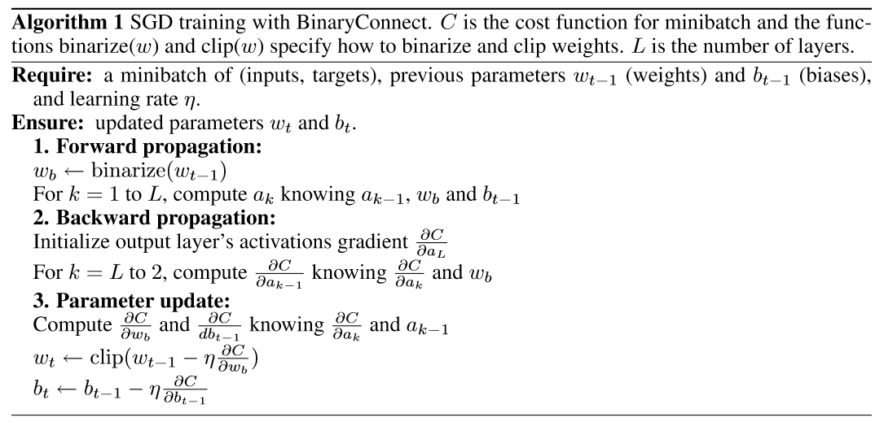
BC-Nips 2015
Training Scheme

Slide 5
BC-Nips 2015
Training Scheme

Slide 6
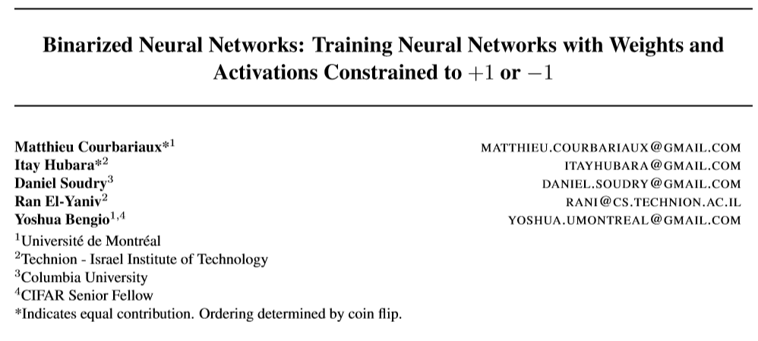
BNN-arXiv 2016

Slide 7
BNN-arXiv 2016

Slide 8
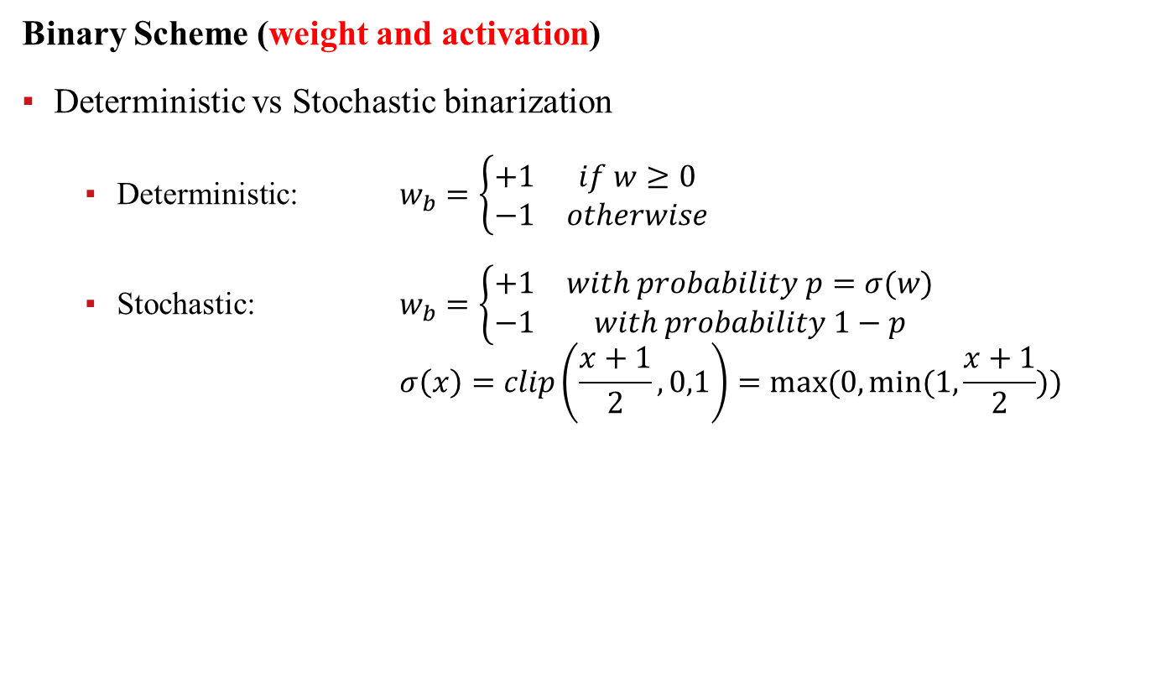
BNN-arXiv 2016
Binary Scheme (weight and activation)
Deterministic vs Stochastic binarization
Deterministic: $w_{b}=\left\{\begin{matrix}+1 & if w≥0 \\ −1 & otherwise\end{matrix}\right.$
Stochastic: $w_{b}=\left\{\begin{matrix}+1 & with probability p=σ(w) \\ −1 & with probability 1−p\end{matrix}\right.$
$$σ\left(x\right)=clip\left(\frac{x+1}{2},0,1\right)=max⁡(0,min⁡(1,\frac{x+1}{2}))$$

Slide 9
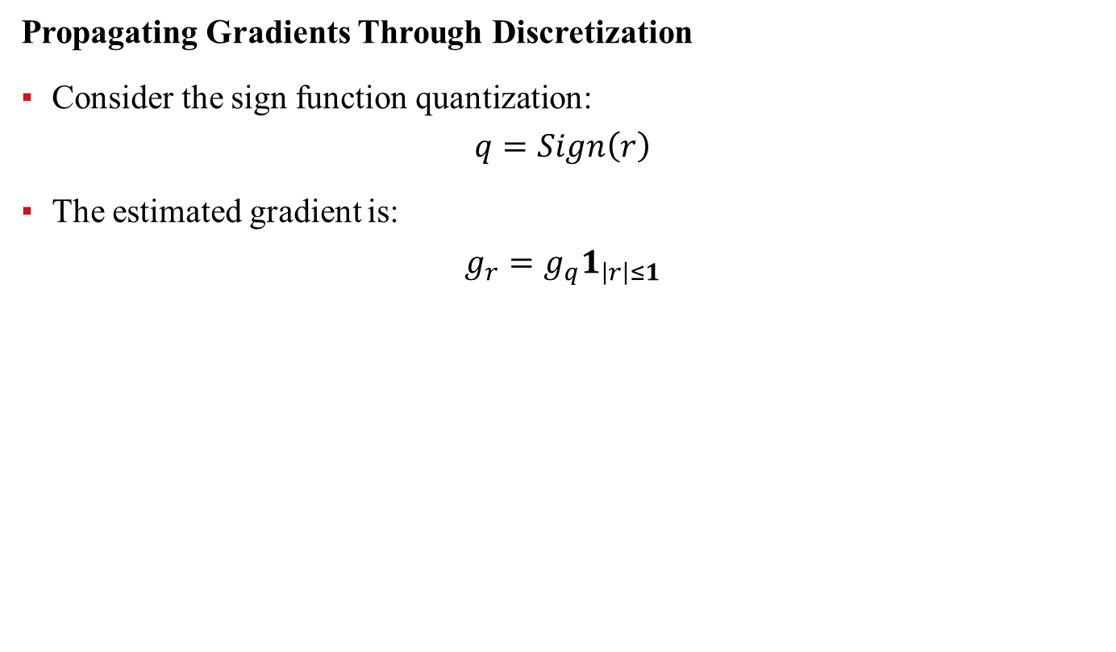
BNN-arXiv 2016
Propagating Gradients Through Discretization
Consider the sign function quantization:
$$q=Sign\left(r\right)$$
The estimated gradient is:
$$g_{r}=g_{q}1_{\left|r\right|≤1}$$

Slide 10
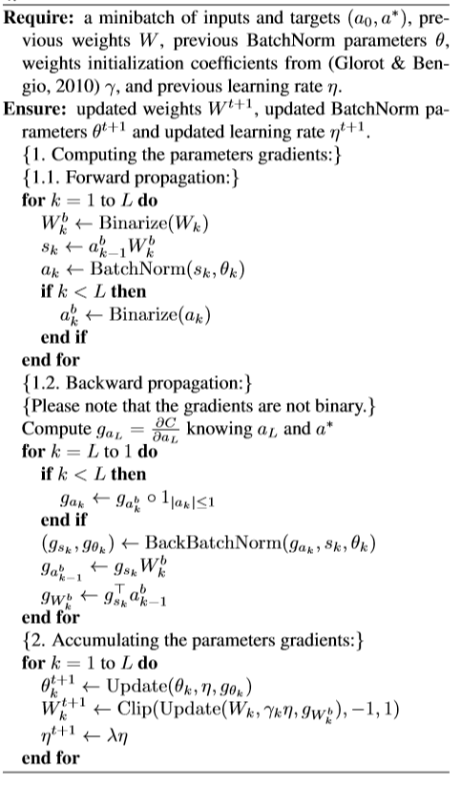
BNN-arXiv 2016
Training Scheme

Slide 11
BNN-arXiv 2016
Training Scheme

Slide 12

BNN-arXiv 2016

Slide 13
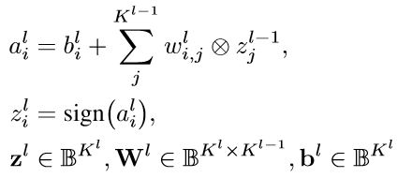
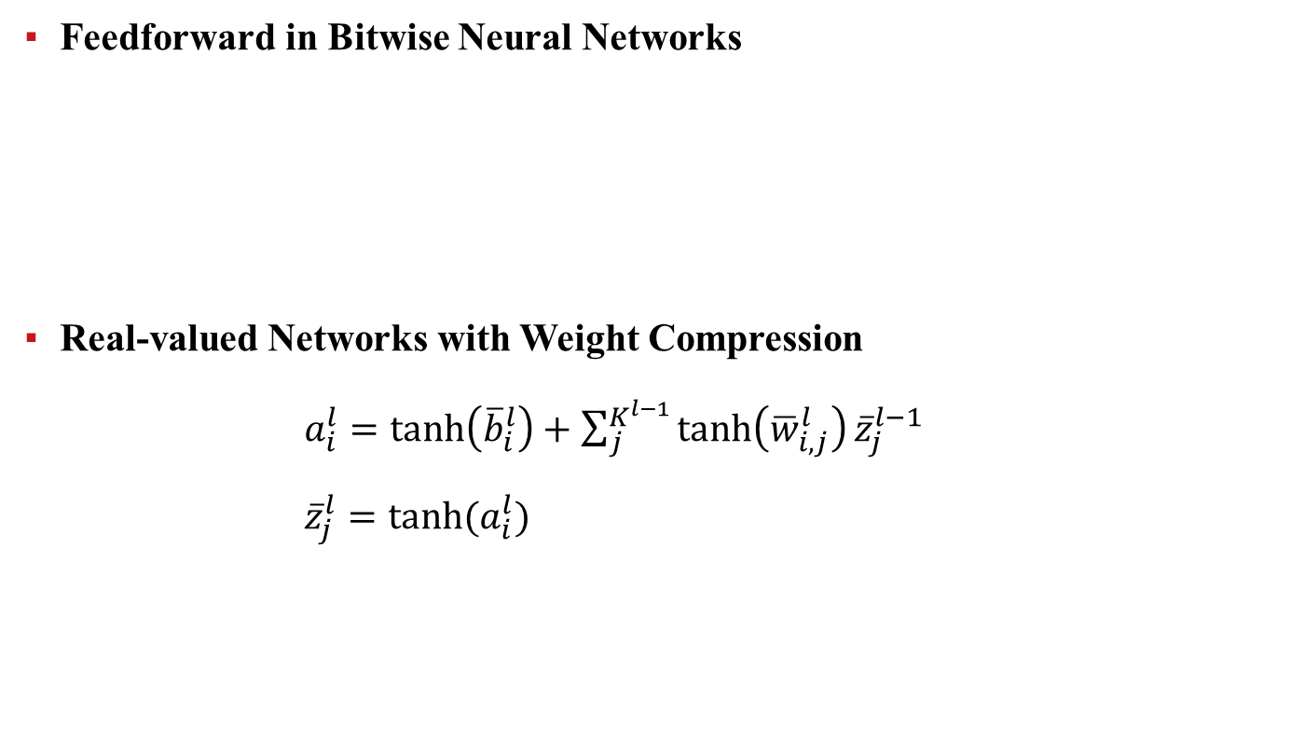
BNN-arXiv 2016
Feedforward in Bitwise Neural Networks
Real-valued Networks with Weight Compression
$a_{i}^{l}=\tanh\left({\overline{b}}_{i}^{l}\right)+\sum_{j}^{K^{l−1}}{\tanh\left({\overline{w}}_{i,j}^{l}\right){\overline{z}}_{j}^{l−1}}$
${\overline{z}}_{j}^{l}=tanh⁡(a_{i}^{l})$

Slide 14
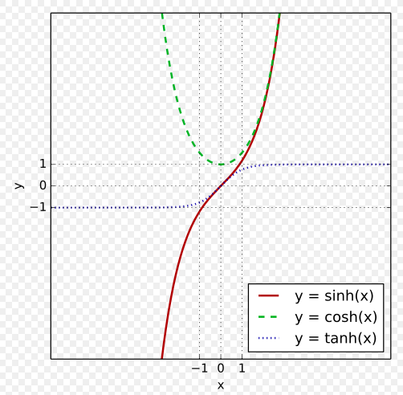
BNN-arXiv 2016

Slide 15
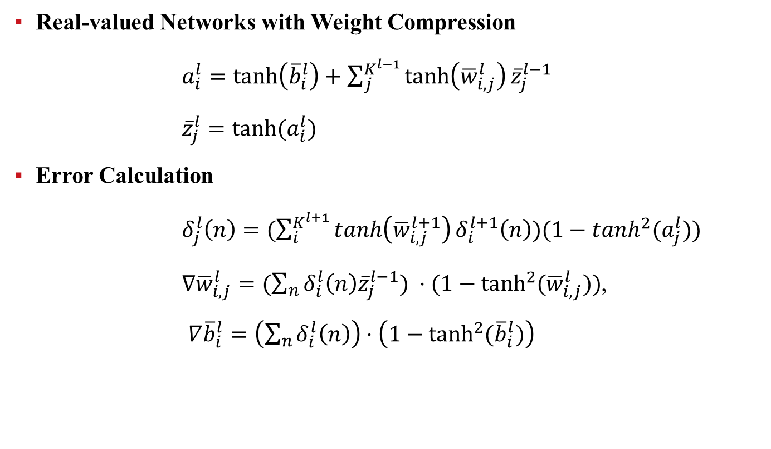
BNN-arXiv 2016
Real-valued Networks with Weight Compression
$a_{i}^{l}=\tanh\left({\overline{b}}_{i}^{l}\right)+\sum_{j}^{K^{l−1}}{\tanh\left({\overline{w}}_{i,j}^{l}\right){\overline{z}}_{j}^{l−1}}$
${\overline{z}}_{j}^{l}=tanh⁡(a_{i}^{l})$
Error Calculation
$δ_{j}^{l}\left(n\right)=(\sum_{i}^{K^{l+1}}{\tanh\left({\overline{w}}_{i,j}^{l+1}\right)δ_{i}^{l+1}\left(n\right)})(1−tanh^{2}(a_{j}^{l}))$
$∇{\overline{w}}_{i,j}^{l}=(\sum_{n}{δ_{i}^{l}\left(n\right){\overline{z}}_{j}^{l−1}}) ⋅(1−\tanh^{2}{({\overline{w}}_{i,j}^{l})})$,
$∇{\overline{b}}_{i}^{l}=\left(\sum_{n}{δ_{i}^{l}\left(n\right)}\right)⋅\left(1−\tanh^{2}{({\overline{b}}_{i}^{l})}\right)$

Slide 16

BWN&XNOR-ECCV 2016

Slide 17
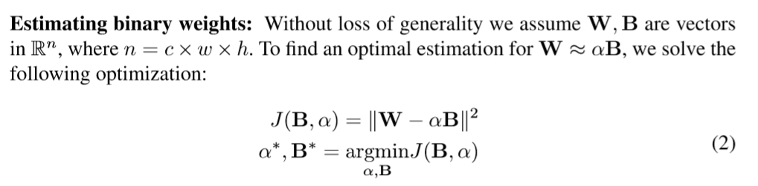
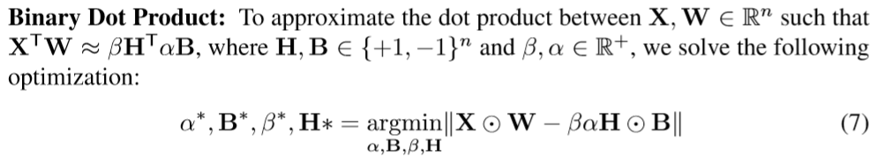
BWN&XNOR-ECCV 2016

Slide 18
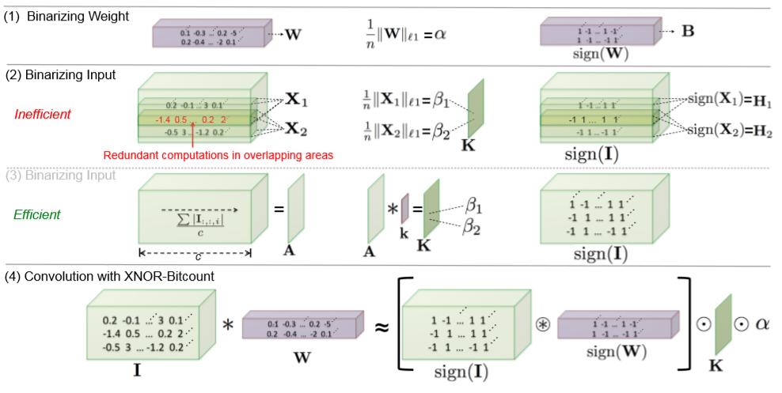
BWN&XNOR-ECCV 2016

Slide 19
BWN&XNOR-ECCV 2016

Slide 20
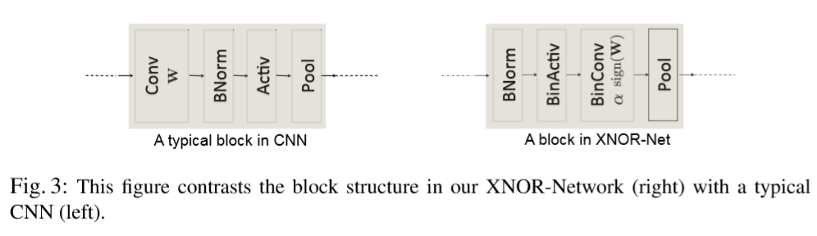
BWN&XNOR-ECCV 2016

Slide 21
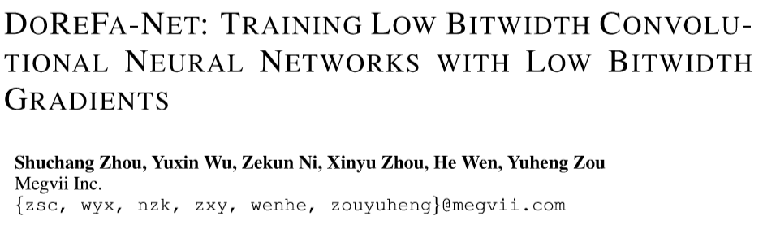
DoReFa-Net-arXiv 2016

Slide 22
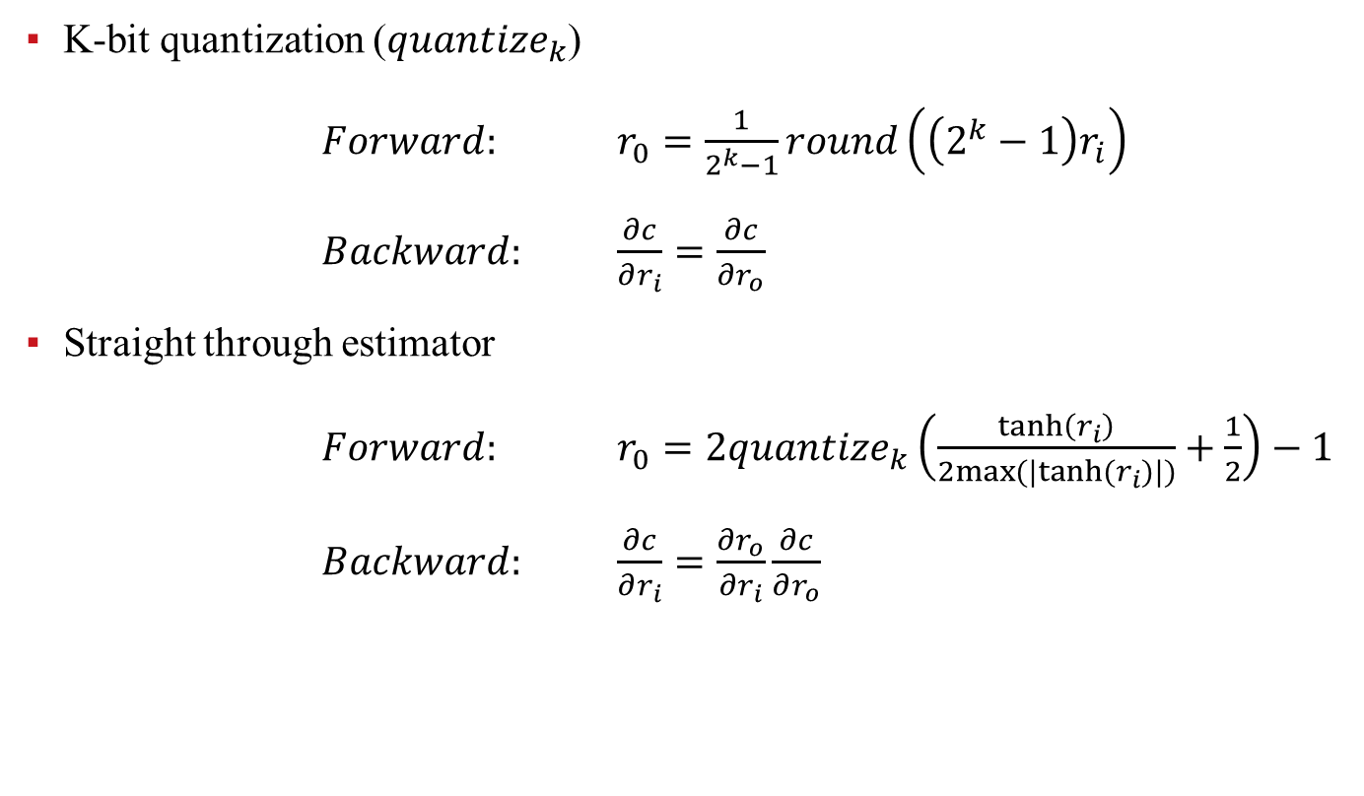
DoReFa-Net-arXiv 2016
K-bit quantization ($quantize_{k}$)
$Forward:$ $r_{0}=\frac{1}{2^{k}−1}round\left(\left(2^{k}−1\right)r_{i}\right)$
$Backward:$ $\frac{∂c}{∂r_{i}}=\frac{∂c}{∂r_{o}}$
Straight through estimator
$Forward:$ $r_{0}=2quantize_{k}\left(\frac{\tanh\left(r_{i}\right)}{2max⁡(|tanh⁡(r_{i})|)}+\frac{1}{2}\right)−1$
$Backward:$ $\frac{∂c}{∂r_{i}}=\frac{∂r_{o}}{∂r_{i}}\frac{∂c}{∂r_{o}}$

Slide 23
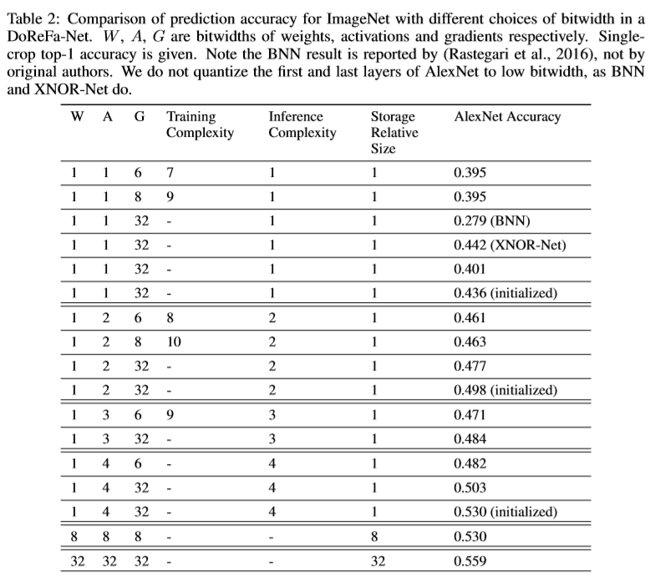
DoReFa-Net-arXiv 2016

Slide 24

TWN-arXiv 2016

Slide 25
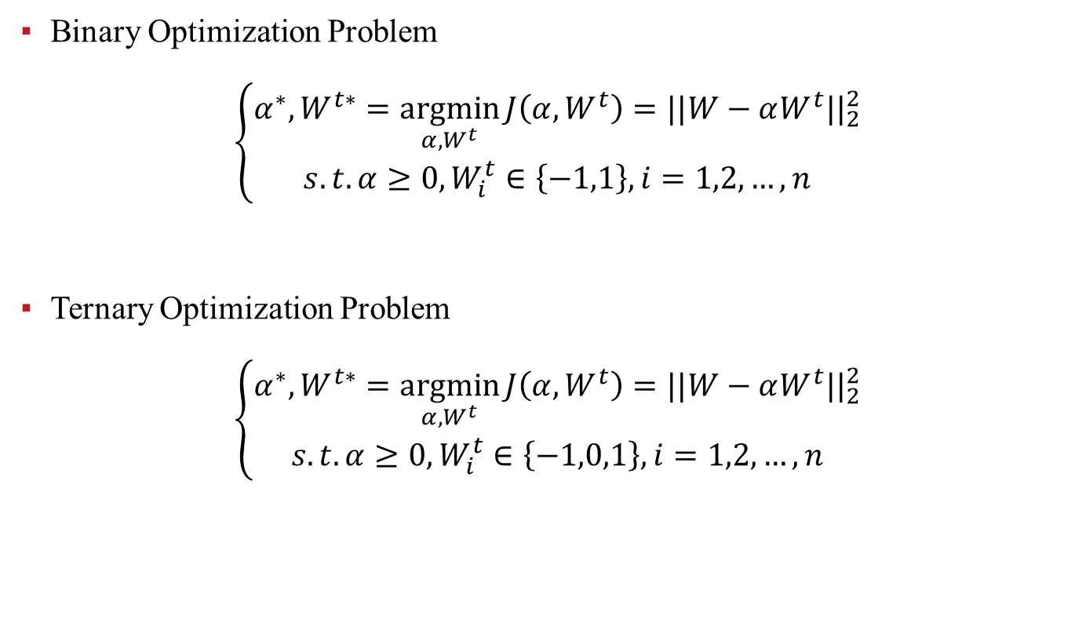
TWN-arXiv 2016
Binary Optimization Problem
$$\left\{\begin{matrix}α^{∗}, W^{t∗}=\underset{α,W^{t}}{argmin}{J\left(α,W^{t}\right)=||W−αW^{t}||_{2}^{2}} \\ s.t. α≥0, W_{i}^{t}∈\left\{−1,1\right\}, i=1,2,…,n\end{matrix}\right.$$
Ternary Optimization Problem
$$\left\{\begin{matrix}α^{∗}, W^{t∗}=\underset{α,W^{t}}{argmin}{J\left(α,W^{t}\right)=||W−αW^{t}||_{2}^{2}} \\ s.t. α≥0, W_{i}^{t}∈\left\{−1,0,1\right\}, i=1,2,…,n\end{matrix}\right.$$

Slide 26
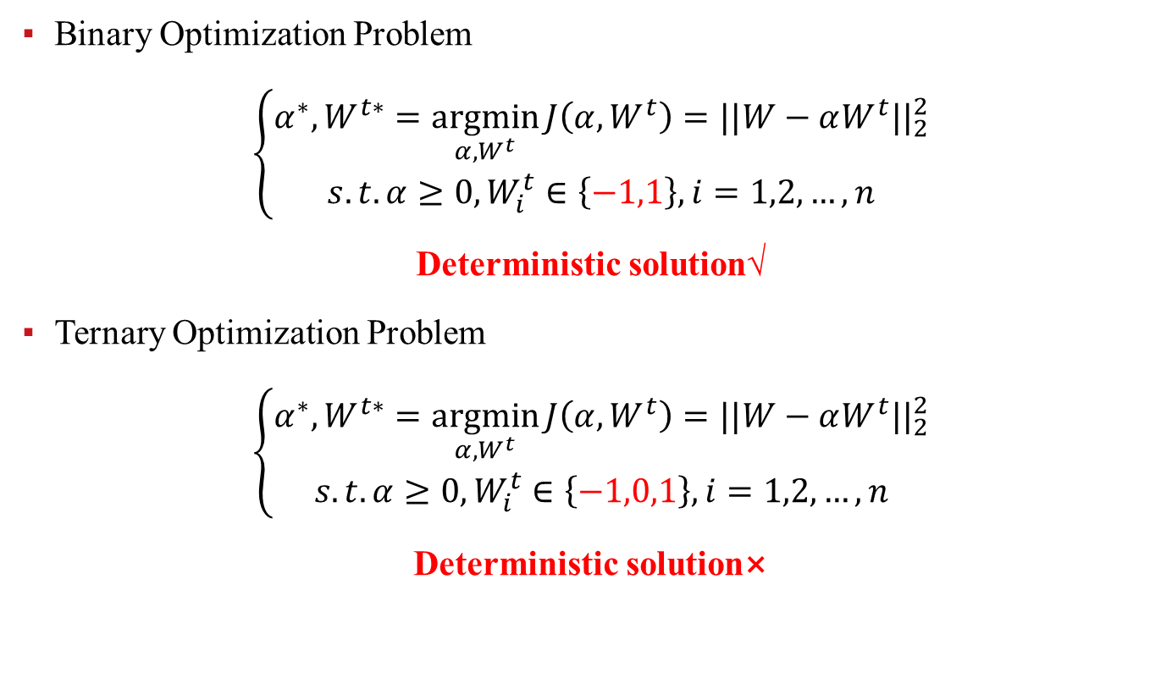
TWN-arXiv 2016
Binary Optimization Problem
$$\left\{\begin{matrix}α^{∗}, W^{t∗}=\underset{α,W^{t}}{argmin}{J\left(α,W^{t}\right)=||W−αW^{t}||_{2}^{2}} \\ s.t. α≥0, W_{i}^{t}∈\left\{−1,1\right\}, i=1,2,…,n\end{matrix}\right.$$
Deterministic solution√
Ternary Optimization Problem
$$\left\{\begin{matrix}α^{∗}, W^{t∗}=\underset{α,W^{t}}{argmin}{J\left(α,W^{t}\right)=||W−αW^{t}||_{2}^{2}} \\ s.t. α≥0, W_{i}^{t}∈\left\{−1,0,1\right\}, i=1,2,…,n\end{matrix}\right.$$
Deterministic solution×

Slide 27
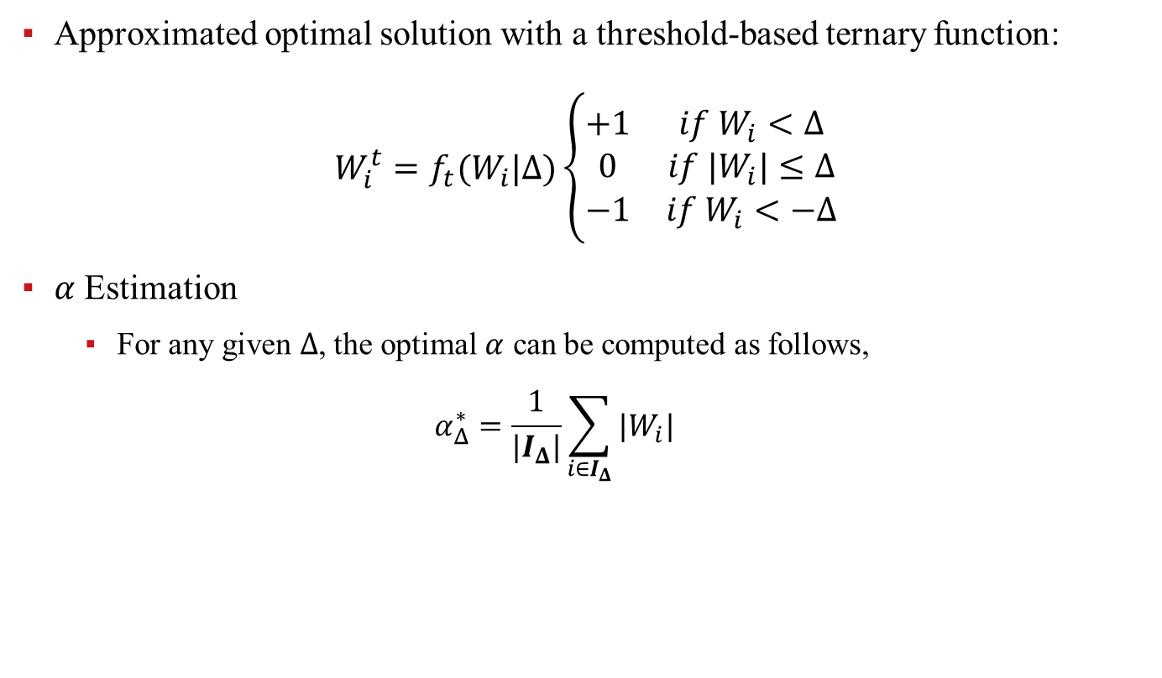
TWN-arXiv 2016
Approximated optimal solution with a threshold-based ternary function:
$$W_{i}^{t}=f_{t}(W_{i}|Δ)\left\{\begin{matrix}+1 & if W_{i}<Δ \\ 0 & if |W_{i}|≤Δ \\ −1 & if W_{i}<−Δ\end{matrix}\right.$$
$α$ Estimation
For any given $Δ$, the optimal $α$ can be computed as follows,
$$α_{Δ}^{∗}=\frac{1}{|I_{Δ}|}\sum_{i∈I_{Δ}}{|W_{i}|}$$

Slide 28
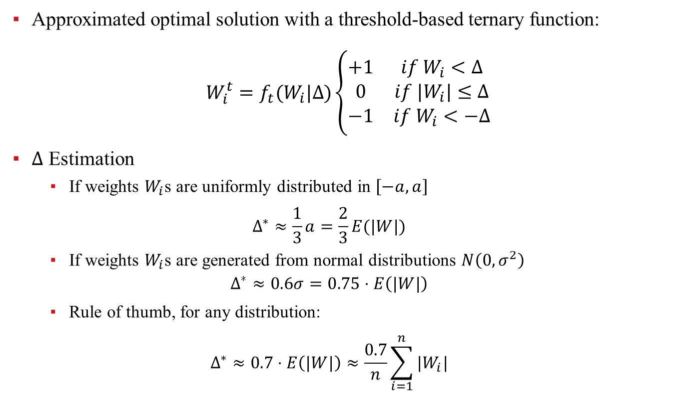
TWN-arXiv 2016
Approximated optimal solution with a threshold-based ternary function:
$$W_{i}^{t}=f_{t}(W_{i}|Δ)\left\{\begin{matrix}+1 & if W_{i}<Δ \\ 0 & if |W_{i}|≤Δ \\ −1 & if W_{i}<−Δ\end{matrix}\right.$$
$Δ$ Estimation
If weights $W_{i}$s are uniformly distributed in $\left[−a, a\right]$
$$Δ^{∗}≈\frac{1}{3}a=\frac{2}{3}E(|W|)$$
If weights $W_{i}$s are generated from normal distributions $N\left(0,σ^{2}\right)$
$$Δ^{∗}≈0.6σ=0.75⋅E\left(|W|\right)$$
Rule of thumb, for any distribution:
$$Δ^{∗}≈0.7⋅E\left(|W|\right)≈\frac{0.7}{n}\sum_{i=1}^{n}{|W_{i}|}$$

Slide 29
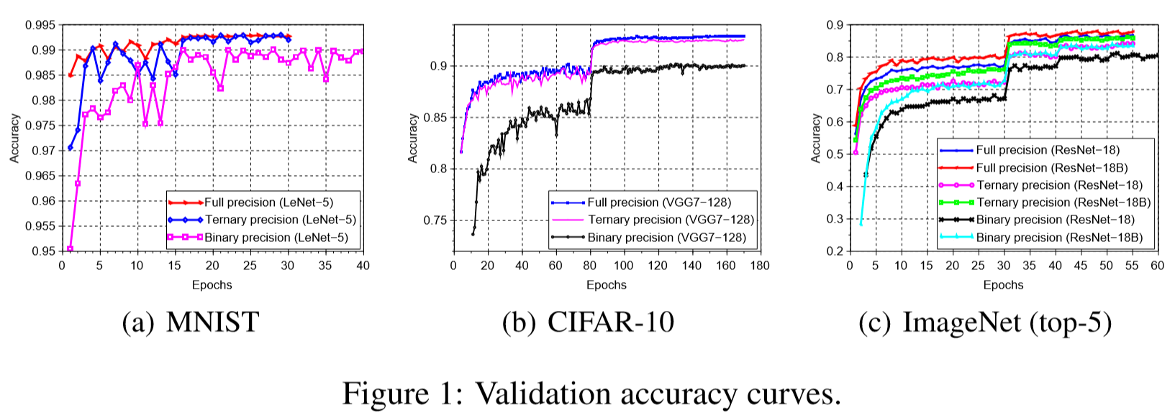
TWN-arXiv 2016

Slide 30

TTQ-ICLR 2017

Slide 31
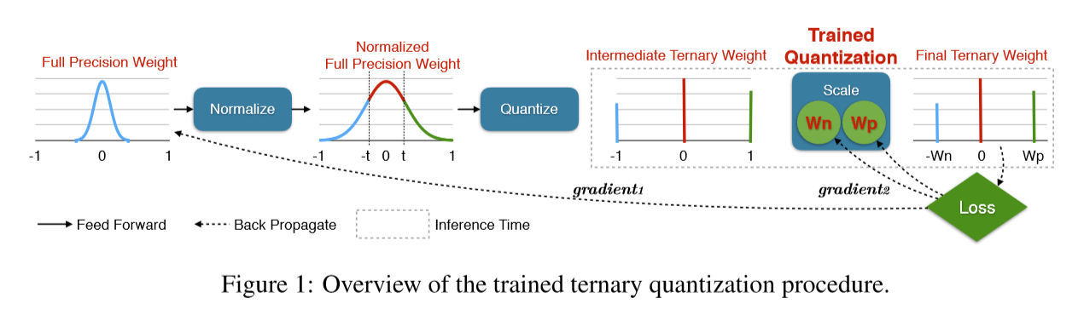
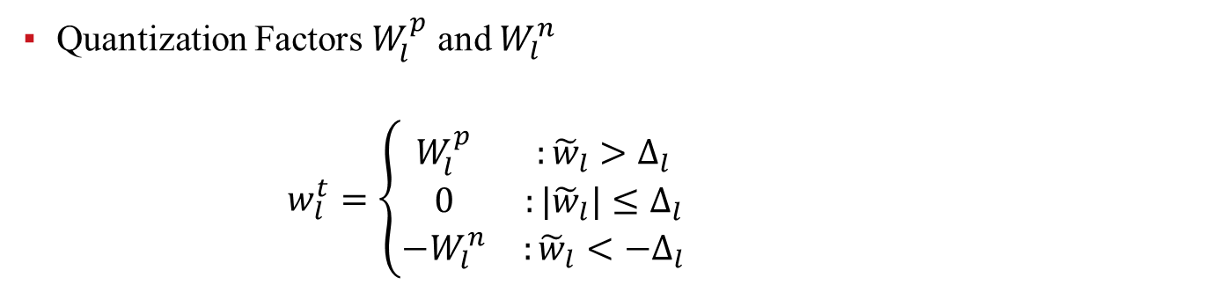
TTQ-ICLR 2017
Quantization Factors $W_{l}^{p}$ and $W_{l}^{n}$
$w_{l}^{t}=\left\{\begin{matrix}W_{l}^{p} & :{\tilde{w}}_{l}>Δ_{l} \\ 0 & :{|\tilde{w}}_{l}|≤Δ_{l} \\ −W_{l}^{n} & :{\tilde{w}}_{l}<{−Δ}_{l}\end{matrix}\right.$

Slide 32
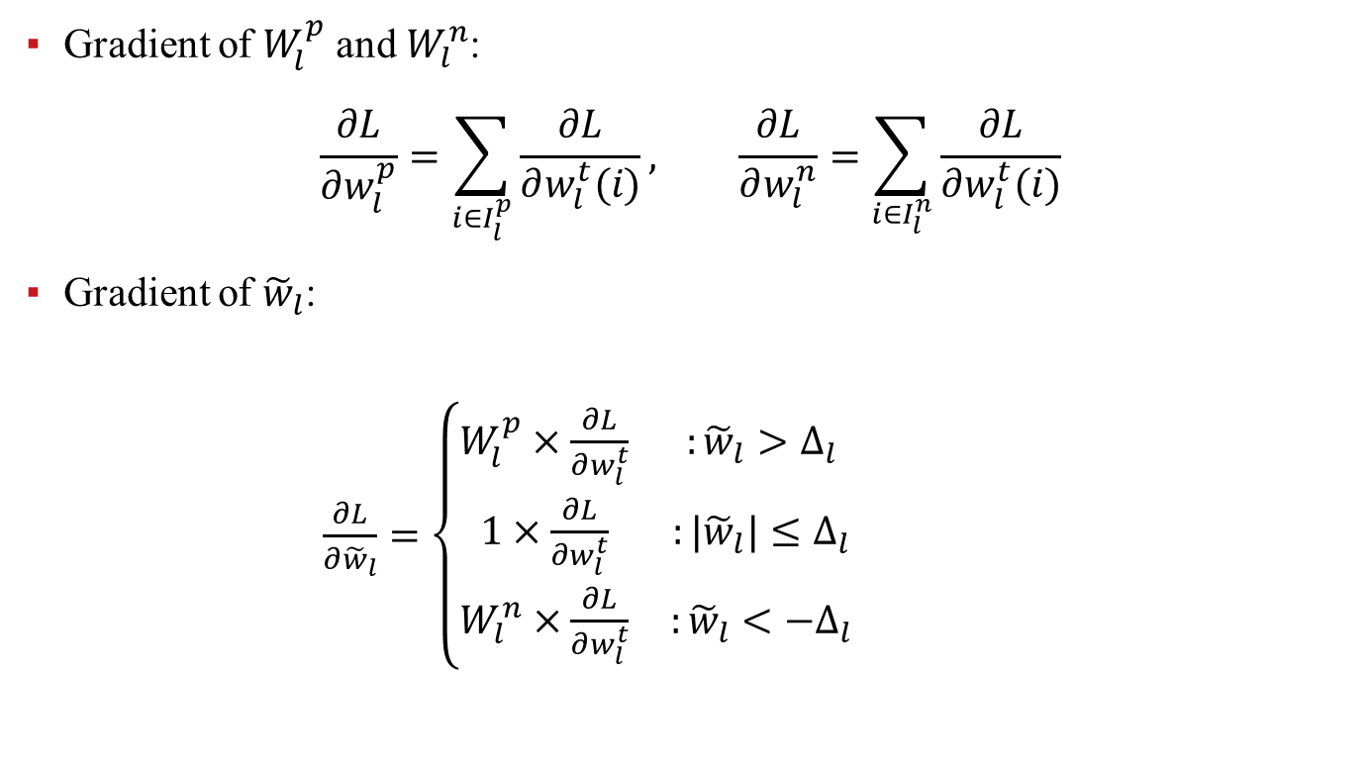
TTQ-ICLR 2017
Gradient of $W_{l}^{p}$ and $W_{l}^{n}$:
$$\frac{∂L}{∂w_{l}^{p}}=\sum_{i∈I_{l}^{p}}{\frac{∂L}{∂w_{l}^{t}(i)}}, \frac{∂L}{∂w_{l}^{n}}=\sum_{i∈I_{l}^{n}}{\frac{∂L}{∂w_{l}^{t}(i)}}$$
Gradient of ${\tilde{w}}_{l}$:
$\frac{∂L}{∂{\tilde{w}}_{l}}=\left\{\begin{matrix}W_{l}^{p}×\frac{∂L}{∂w_{l}^{t}} & :{\tilde{w}}_{l}>Δ_{l} \\ 1×\frac{∂L}{∂w_{l}^{t}} & :{|\tilde{w}}_{l}|≤Δ_{l} \\ W_{l}^{n}×\frac{∂L}{∂w_{l}^{t}} & :{\tilde{w}}_{l}<{−Δ}_{l}\end{matrix}\right.$

Slide 33
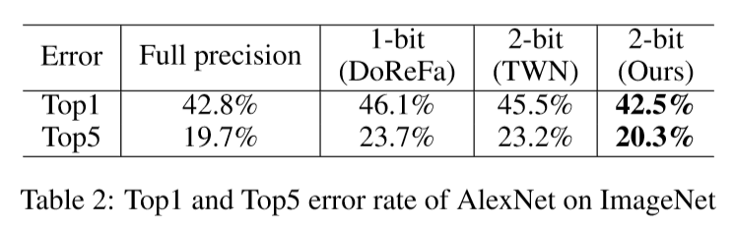
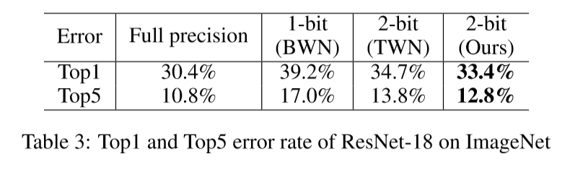
TTQ-ICLR 2017

Slide 34
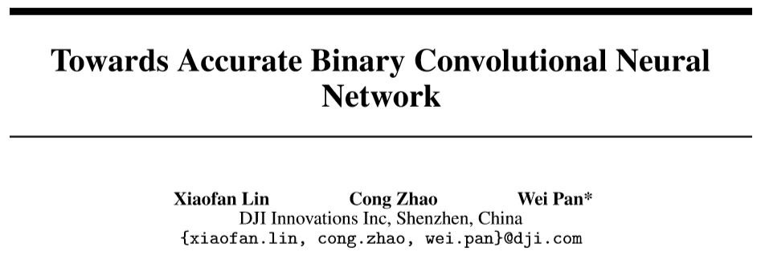
ABC-NIPS 2017

Slide 35
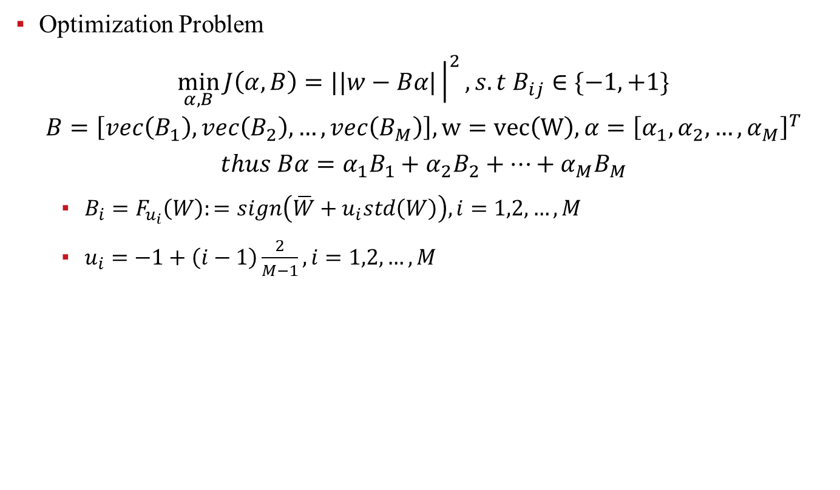
ABC-NIPS 2017
Optimization Problem
$$\min_{α,B}{J\left(α, B\right)=||w−Bα|{\left.​\right|}^{2}, s.t B_{ij}∈\{−1,+1\}}$$
$$B=\left[vec\left(B_{1}\right),vec\left(B_{2}\right),…,vec\left(B_{M}\right)\right], w=vec\left(W\right), α={\left[α_{1},α_{2},…,α_{M}\right]}^{T}$$
$$thus Bα=α_{1}B_{1}+α_{2}B_{2}+…+α_{M}B_{M}$$
$B_{i}=F_{u_{i}}\left(W\right):=sign\left(\overline{W}+u_{i}std\left(W\right)\right), i=1,2,…,M$
$u_{i}=−1+\left(i−1\right)\frac{2}{M−1}, i=1,2,…,M$

Slide 36
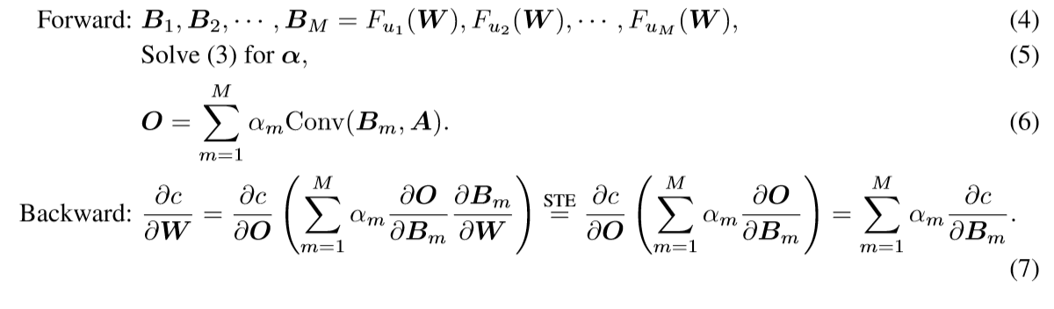
ABC-NIPS 2017
Propagation Procedure

Slide 37

HWGQ-CVPR 2017

Slide 38
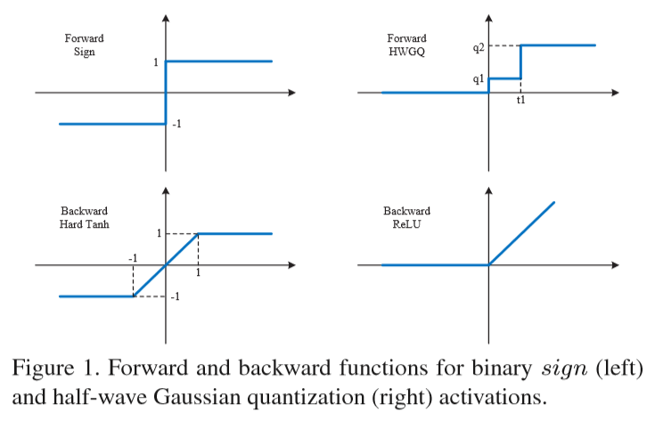
HWGQ-CVPR 2017

Slide 39
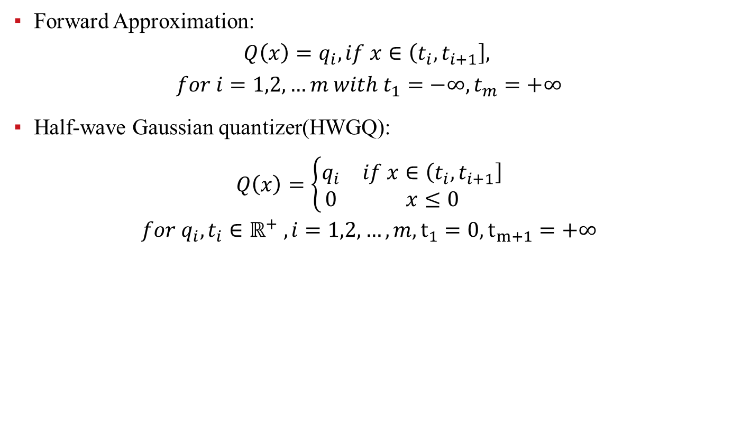
HWGQ-CVPR 2017
Forward Approximation:
$$Q\left(x\right)=q_{i}, if x∈\left(t_{i},t_{i+1}\right],$$
$$for i=1,2,…m with t_{1}=−∞,t_{m}=+∞$$
Half-wave Gaussian quantizer(HWGQ):
$$Q\left(x\right)=\left\{\begin{matrix}q_{i} & if x∈\left(t_{i},t_{i+1}\right] \\ 0 & x≤0\end{matrix}\right.$$
$$for q_{i},t_{i}∈ℝ^{+} , i=1,2,…,m, t_{1}=0,t_{m+1}=+∞$$

Slide 40
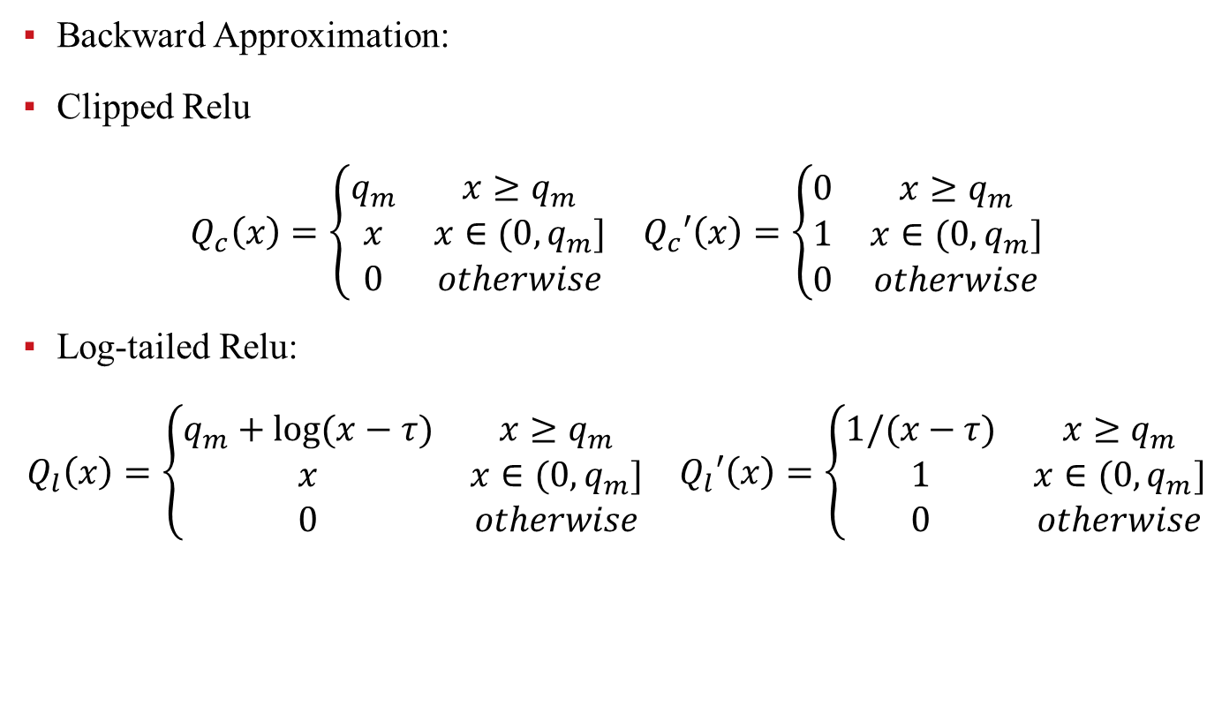
HWGQ-CVPR 2017
Backward Approximation:
Clipped Relu
$$\begin{matrix}Q_{c}\left(x\right)=\left\{\begin{matrix}q_{m} & x≥q_{m} \\ x & x∈(0,q_{m}] \\ 0 & otherwise\end{matrix}\right. & Q_{c}′\left(x\right)=\left\{\begin{matrix}0 & x≥q_{m} \\ 1 & x∈(0,q_{m}] \\ 0 & otherwise\end{matrix}\right.\end{matrix}$$
Log-tailed Relu:
$$\begin{matrix}Q_{l}\left(x\right)=\left\{\begin{matrix}q_{m}+log⁡(x−τ) & x≥q_{m} \\ x & x∈(0,q_{m}] \\ 0 & otherwise\end{matrix}\right. & Q_{l}′\left(x\right)=\left\{\begin{matrix}1/(x−τ) & x≥q_{m} \\ 1 & x∈(0,q_{m}] \\ 0 & otherwise\end{matrix}\right.\end{matrix}$$

Slide 41
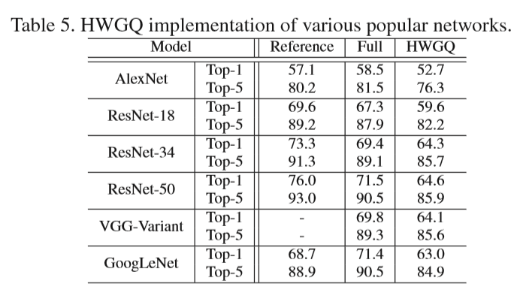
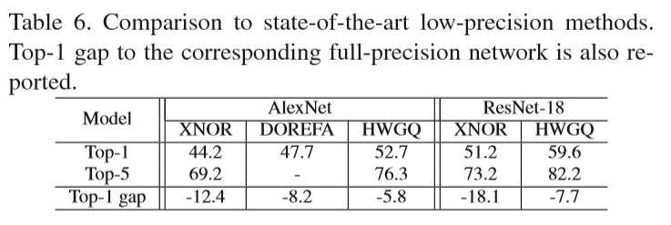
HWGQ-CVPR 2017

Slide 42

INQ-ICLR 2017

Slide 43
INQ-ICLR 2017

Slide 44
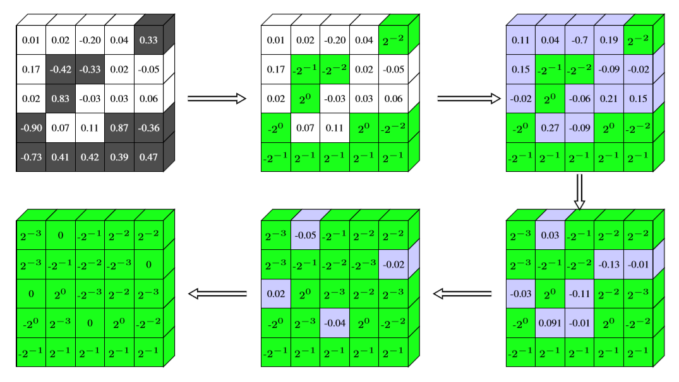
INQ-ICLR 2017

Slide 45
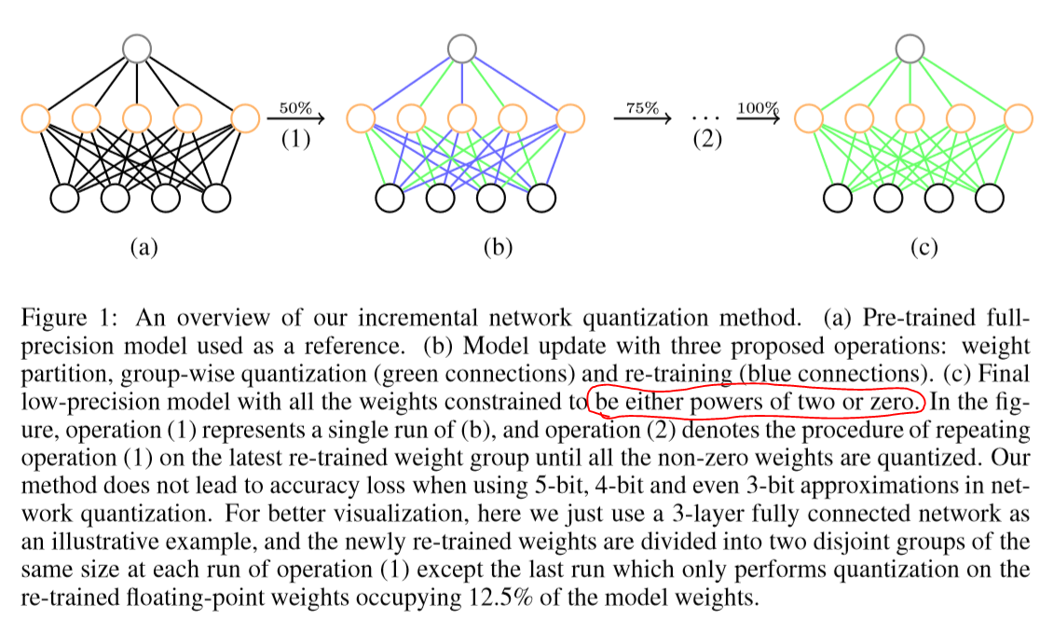
INQ-ICLR 2017

Slide 46
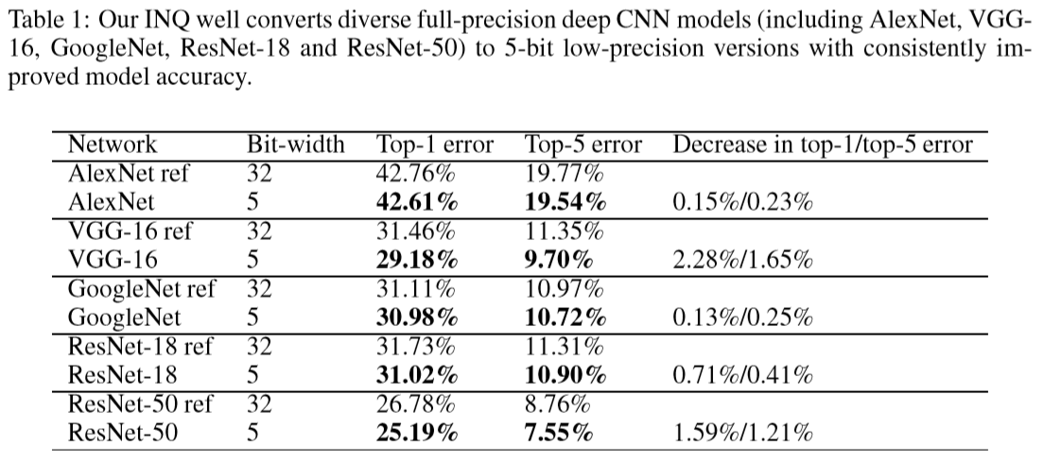
INQ-ICLR 2017

Slide 47

S/MLQ-AAAI 2018

Slide 48
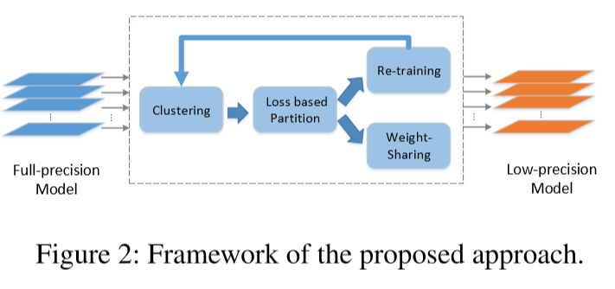
S/MLQ-AAAI 2018
Clustering: use k-means clustering to cluster the weights into k clusters layer-wise
Loss based partition: divide k clusters of each layer into two groups based on the quantization loss
Re-training and weight sharing: quantize the weight to the clustering centroid

Slide 49
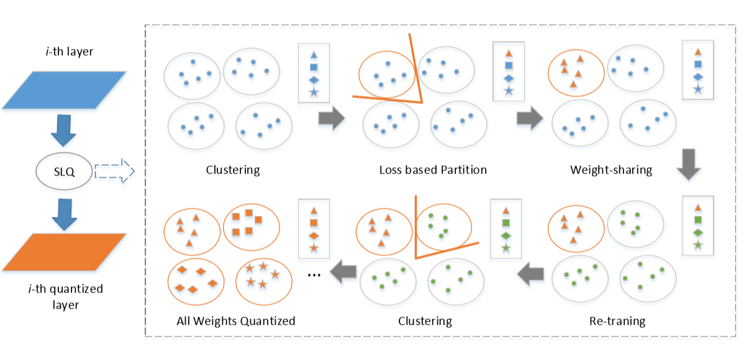
S/MLQ-AAAI 2018

Slide 50
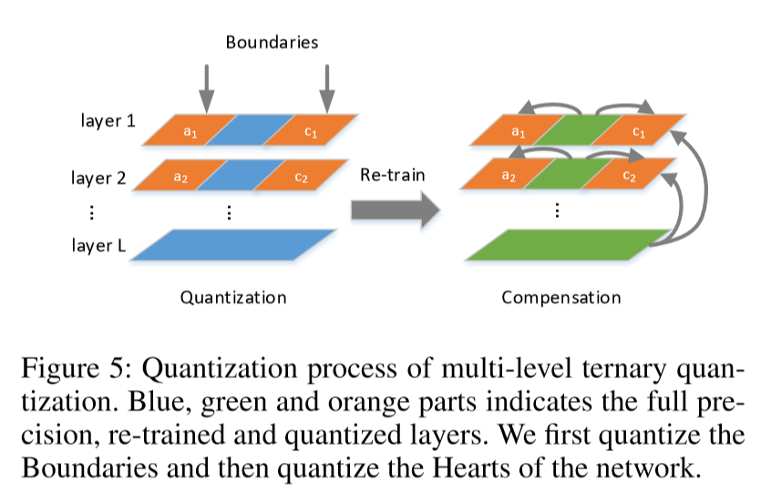
S/MLQ-AAAI 2018

Slide 51
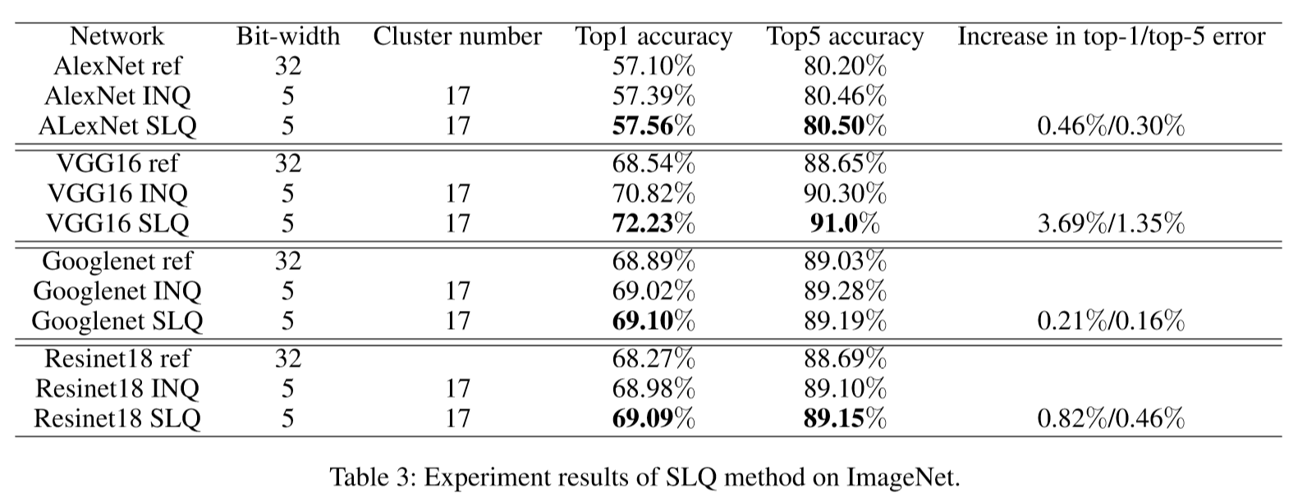
S/MLQ-AAAI 2018

Slide 52
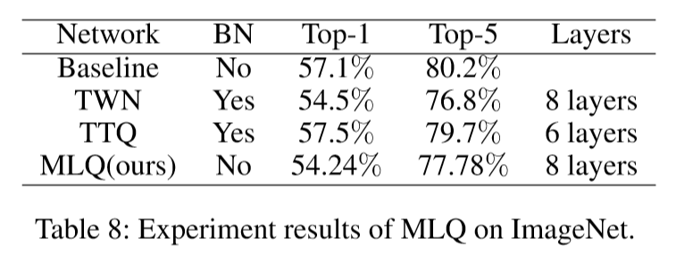
S/MLQ-AAAI 2018

Slide 53
谢 谢！

